Slide 1

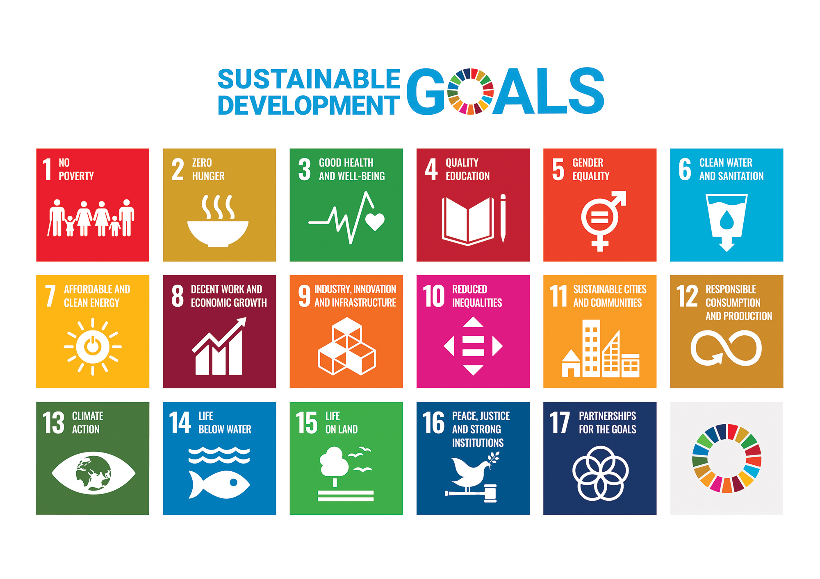
Sustainable Development Goals (SDGs) – Overview
Subject: ESSR (BE04000101) | Semester: 4 |
Guided by: Hema Vanar
College: SAL College of Engineering |
Name: Maheriya Hardikbhai Sureshbhai |
Enrollment No: 251133107016

Slide 2
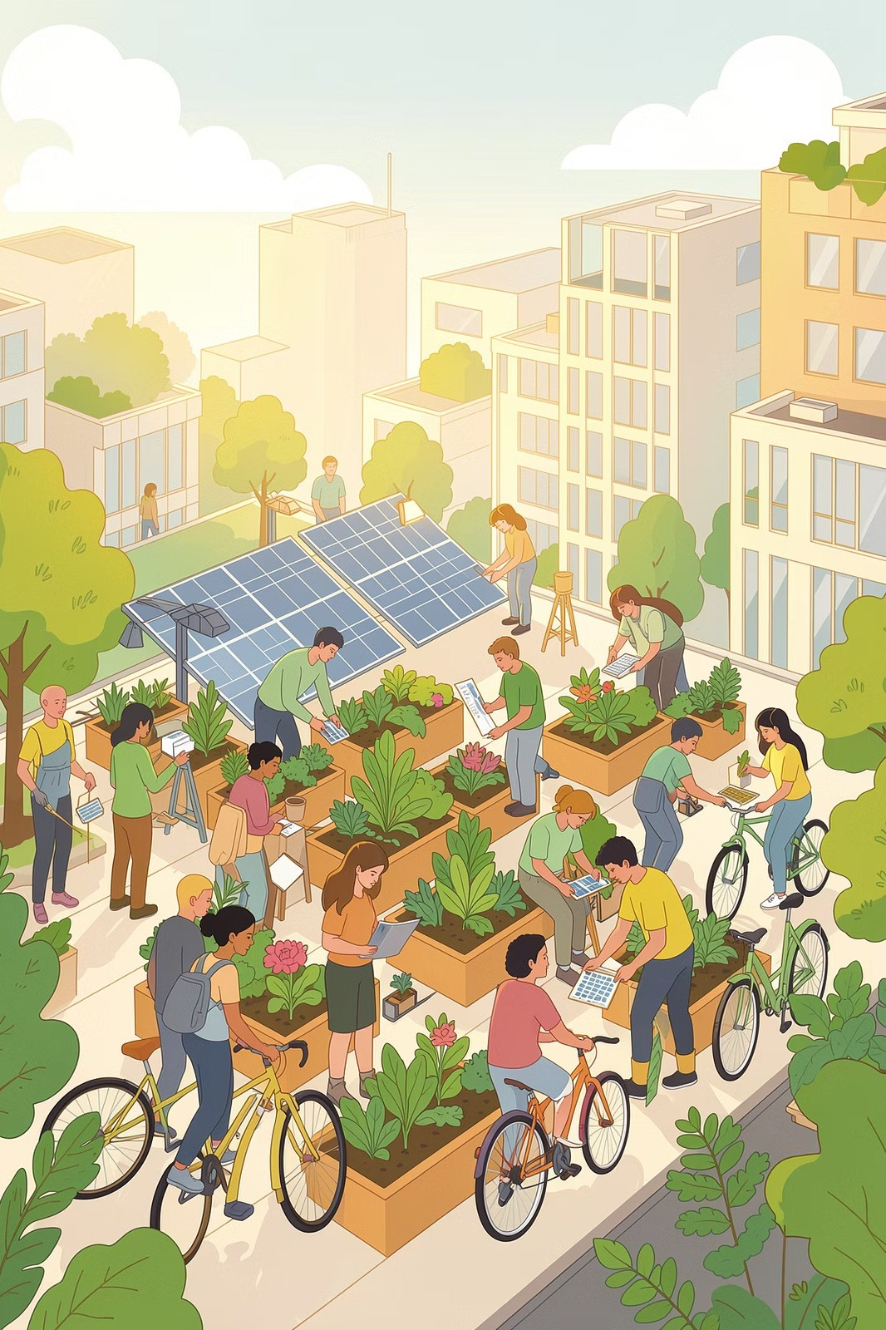
Introduction
Meeting Present Needs
Sustainable development meets the needs of the present without compromising the ability of future generations to meet their own needs.
Three Pillars of Balance
A careful balance between economic growth, social inclusion, and
environmental protection is at the heart of sustainability.
A Global Framework
The SDGs provide a universally agreed framework that guides nations, organisations, and individuals towards meaningful, lasting progress.

Slide 3
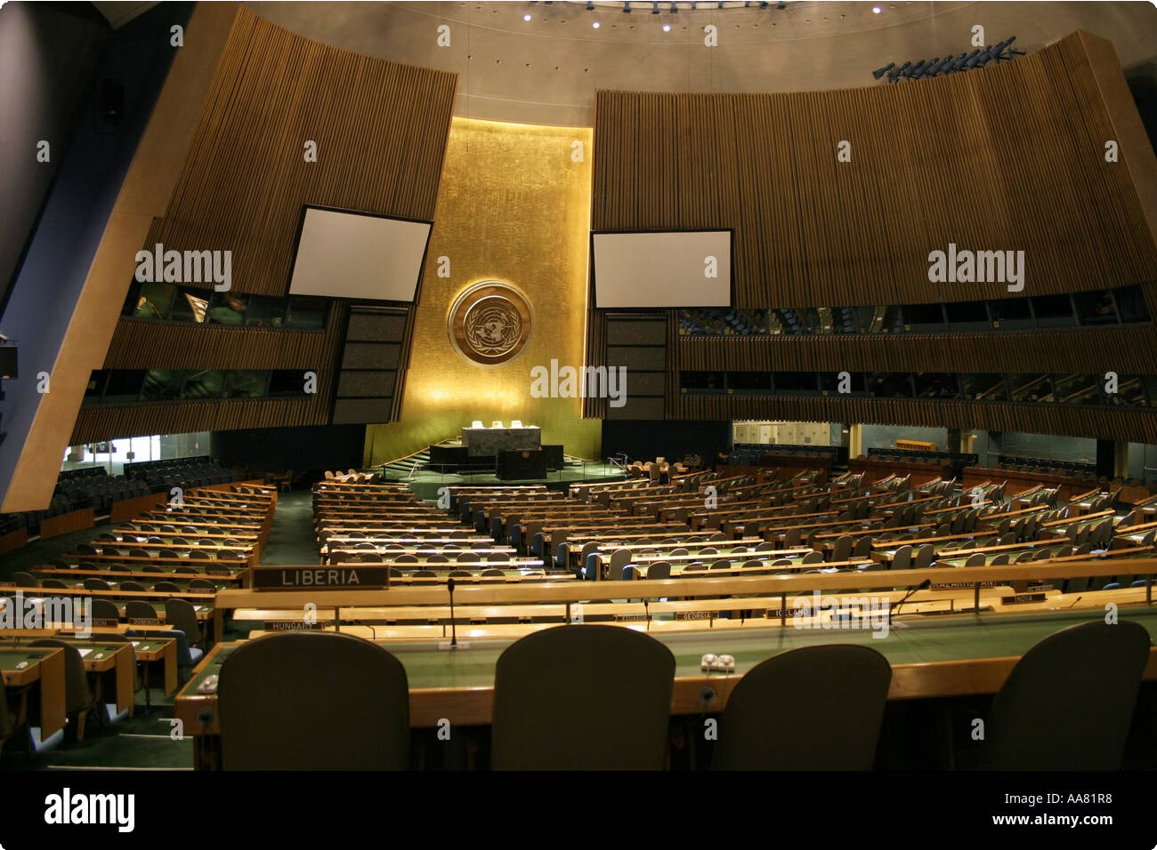

What are SDGs?
2030 AGENDA
17 Goals for a Better World
The Sustainable Development Goals are 17 global goals adopted by all United Nations Member States in 2015. They form the core of the 2030 Agenda for Sustainable Development.
Their overarching aim is to achieve a better and more sustainable future for all people on the planet by the year 2030 — addressing the root causes of poverty, inequality, and climate change.
Adopted unanimously by 193 UN Member States in September 2015.

Slide 4




Key Features of the SDGs
Universal
Applicable to all countries — developed and developing alike. No nation is exempt from the responsibility to act.
Integrated & Interconnected
Progress in one goal supports others. The goals are designed to work together as a unified system.
Inclusive
Built on the principle of "leaving no one behind" — ensuring the most vulnerable populations are prioritised.
169 Measurable Targets
Backed by 169 specific targets and hundreds of indicators to track and measure real-world progress.

Slide 5
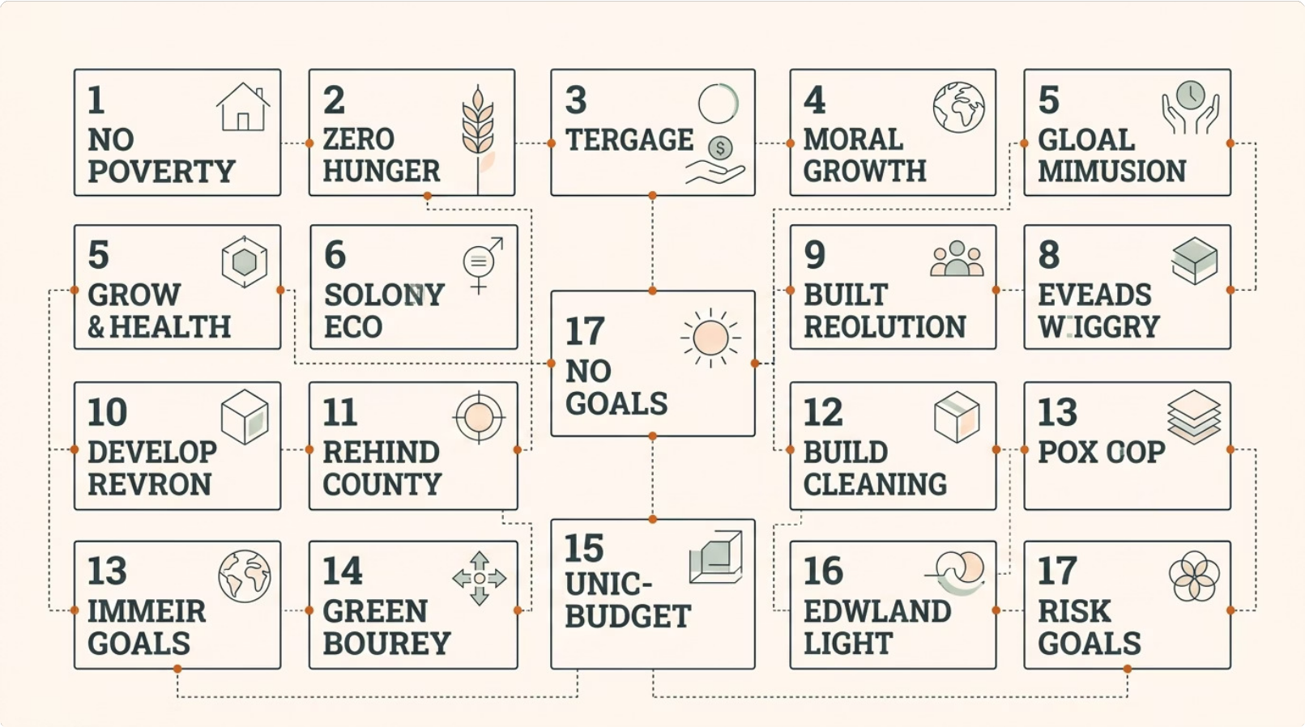
All 17 SDGs – Overview
The 17 SDGs span three dimensions of sustainable development — social, economic, and environmental — forming a comprehensive blueprint for a prosperous and equitable world by 2030.

Slide 6

Goals 1–3: People & Health
n Goal 1 – No Poverty
End poverty in all its forms everywhere. Improve living standards and ensure social protection for the most vulnerable people across the globe.
Goal 2 – Zero Hunger
End hunger, achieve food security, improve nutrition, and promote sustainable agriculture to feed a growing global population.
❤ Goal 3 – Good Health
Ensure healthy lives and promote well-being for all at all ages through better healthcare systems, disease prevention, and universal health coverage.

Slide 7

Goals 4–5: Education & Equality
GOAL 4
Quality Education
Ensure inclusive and equitable quality education and promote lifelong learning opportunities for all. This includes access to early childhood development, vocational training, and higher education — leaving no learner behind.
GOAL 5
Gender Equality
Achieve gender equality and empower all women and girls. This means eliminating discrimination, ensuring equal opportunities in education and employment, and ending all forms of violence against women.

Slide 8


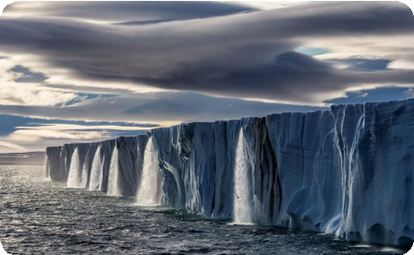
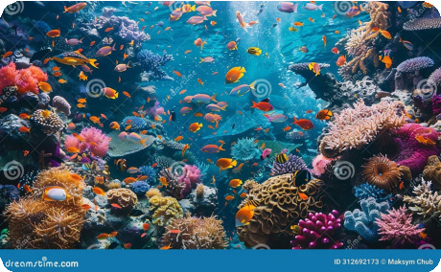

Environmental Goals
Clean Water & Sanitation
Ensure availability and sustainable management of water and sanitation for all.
Affordable & Clean Energy
Ensure access to affordable, reliable, sustainable, and modern energy for all.
Climate Action
Take urgent action to combat climate change and its devastating impacts on communities worldwide.
Life Below Water & On Land
Protect oceans, seas, forests, and terrestrial ecosystems — conserving biodiversity and natural resources for future generations.
➡ Together, these goals form a shield for our planet's most precious natural resources.

Slide 9
Economic & Social Goals
ECONOMIC
Driving Prosperity
Economic Growth
Promote sustained, inclusive, and sustainable economic growth and full, productive employment for all.
Innovation & Infrastructure
Build resilient infrastructure, promote inclusive industrialisation, and foster innovation across sectors.
Responsible Consumption
Ensure sustainable consumption and production patterns to reduce waste and environmental impact.
SOCIAL
Building Fairer Societies
Reduced Inequality
Reduce inequality within and among countries, ensuring fair distribution of resources and opportunities.
Sustainable Cities
Make cities and human settlements inclusive, safe, resilient, and sustainable for growing urban populations.
Peace & Justice
Promote peaceful and inclusive societies, provide access to justice for all, and build effective institutions.

Slide 10

Importance & Conclusion
Reduces Poverty & Inequality
The SDGs directly target the root causes of poverty and social exclusion, creating pathways to a more equitable world.
Protects the Environment
By addressing climate change, biodiversity loss, and resource depletion, the SDGs safeguard the planet for future generations.
Ensures Peace & Cooperation
The goals foster global partnerships, peaceful institutions, and international cooperation across all nations.
The SDGs are essential for our shared future. Every individual, institution, and government must contribute to achieving these goals by 2030. The time to act is now.

